Slide 1
UNIT III – OpenFlow, Programmability and the Management Interface
UNIT I – SESSION 1
SESSION 7
  Introduction to Network Function Virtualization
  Virtualization and Data Plane I/O
  Services Engineered Path
  Reference: Ref. 2, Ch.7 (Page No. 207 to 216)

Slide 2
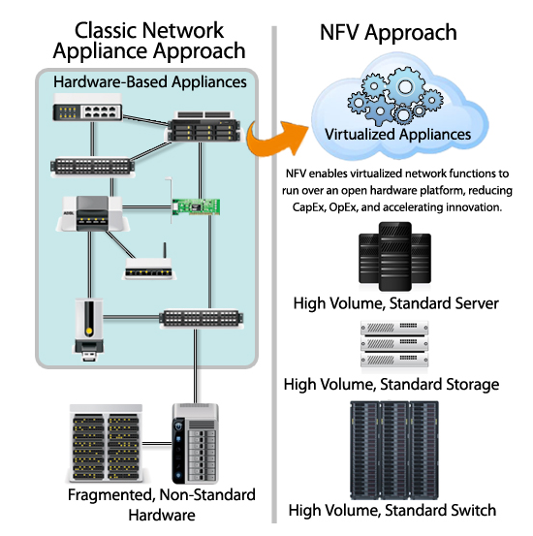
Network Function Virtualization

Slide 3
Introduction to Network Function Virtualization
Network Function Virtualization (NFV) builds on including control/data plane separation, virtualization, SDN controllers, and data center concepts (particularly orchestration applications).
Objective is reduction on CapEx and OpEX
Network Function Virtualization has its roots in network operations problems, particularly the implications of bundling services by network equipment manufacturers within their platform OS.
NFV also applies to appliance vendors in a way that does not take advantage of the processing scale/innovation seen by many customers in their data centers.
Many large service providers had their own cloud offerings and thus an assumption of virtual machine orchestration in their operation.
They were also tracking the I/O innovations by Intel like (Virtualization Technology for Directed I/O) VT-d, (Data Direct I/O Technology) DDIO, (Data Plane Development Kit) DPDK, and SR-IOV (single root I/O virtualization) support).

Slide 4
Introduction to Network Function Virtualization
Behind the scenes, vendors were also already tracking the evolving I/O capabilities of COTS (Commercial Off-the-Shelf) platforms and evaluating strategies for the next generation of service appliances and the future of dedicated network platforms that incorporate a large services component.
These include the Broadband Network Gateway (BNG), its parallel in the cable space (CMTS), the node-B in the mobile space, and other service-oriented access and aggregation platforms.
What has evolved is a discussion of network services and functions into three general categories: simple virtualized services, service chaining, and services or platform virtualization.

Slide 5
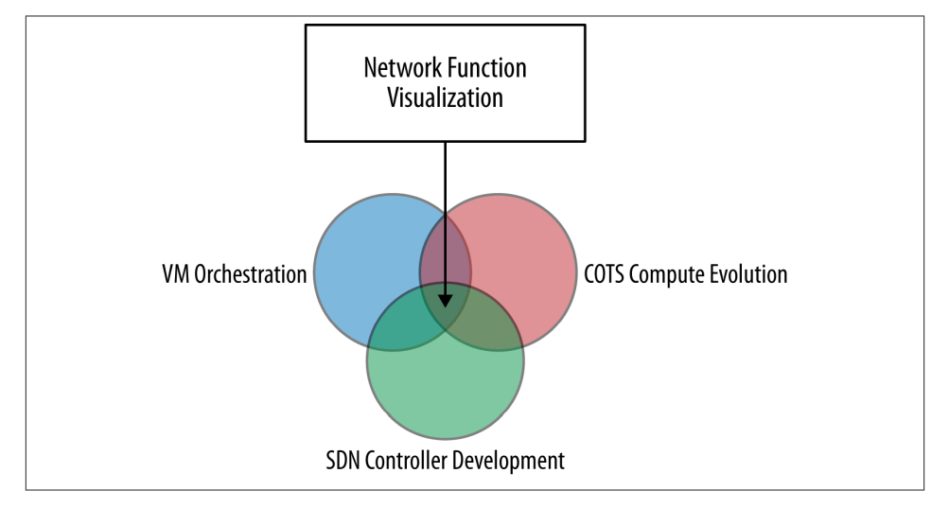
The intersection that makes Network Function Virtualization possible

Slide 6
Virtualization
Virtualization of network services doesn’t necessarily mean separate hypervisor partitioned VMs that contain each service instance; instead, it could also mean:
Services implemented in a machine with multiple/compartmentalized OS(s)
Services implemented within the hypervisor
Services implemented as distributed or clustered as composites
Services on bare metal machines (Bare metal refers to a physical computer, specifically a server, that has one and only one operating system.)
Services implemented in Linux virtual containers.
These methods may share state by using some form of Network Attached Storage (NAS) or other shared storage/memory architectures.
Virtual machines provide tremendous advantages with respect to management and are thus pursued as a primary vehicle for NFV.

Slide 7
Virtualization
Linux containers have advantages in density (more instances per host) and performance but lack the management ecosystem and OS flexibility of virtual machines.
Of course, bare metal machines trump both options when it comes to performance but are often considered behind the curve in terms of flexibility and management.
Technologies like the Virtual Ethernet Port Extension (VEPA) port extension may also present an opportunity to provide per-VM services in a switch/router context using built-in or adjunct services.
Virtualization of network services will introduce reliability concerns that NFV practices and recommendations need to address:

Slide 8
Virtualization
The introduction of the hypervisor and the potential of multiple virtualized services on the same physical hardware can lead to contention for physical resources, resulting in a potential degradation experienced by individual services/functions or a whole chain via that single component.
Not only will the NFV orchestration system need to monitor for such degradation, it will need visibility into the hypervisor and host resources to troubleshoot and potentially isolate/mitigate the contention.
The hypervisor itself introduces a potential single point of failure (SPOF) that can impact many concurrent VMs on a host and potentially many different service chains.
The hypervisor virtual switch can congest while serving the multiple vNICs of the various VMs and needs to be able to identify and prioritize control traffic to avoid application and management failure.

Slide 9
Virtualization
Additionally, the hypervisor can isolate the applications from awareness of changes in physical machine state like failure of a NIC port.
This management awareness needs to be bridged by SDN controller and Orchestration cooperation.
Finally, virtual machines can also be migrated while operating as part of a high availability (HA) strategy.
This behavior can impact a service chain in different ways, and so this behavior is sometimes intentional or unintentional as part of this strategy insofar as being used for HA capabilities.

Slide 10
Data Plane I/O
I/O acceleration techniques that are software (OS or hypervisor) based include Virtio and SR-IOV:
Virtio is the main platform for disk and network I/O virtualization in Linux, FreeBSD (Berkeley Software Distribution), and other operating systems.
Virtio provides a layer of abstraction over devices in a para-virtualized hypervisor/VMM (Paravirtualization is a type of virtualization where software instructions from the guest operating system running inside a virtual machine) and provides I/O benefits when compared to full virtualization.
SR-IOV (Single Root I/O Virtualization) works with the class of I/O hard‐ ware built around PCIe (Peripheral Component Interconnect Express) technology. This PCIe specification splits a device into multiple PCI Express Requester IDs (it splits physical functions into lighter-weight virtual functions), allowing the I/O MMU to distinguish between individual traffic streams, apply memory/interrupt translations, and perform delivery directly to a VM (each PCI Express virtual function, mapped to an ID, can be assigned to a VM).
This bypasses the software switch layer and reduces the impact of software emulation on I/O.

Slide 11
Data Plane I/O
The mapping ratio of physical device to virtual device is 1:256.
The PCIE virtual functions appear to be hardware devices to the VM.
All data packets flow directly between the specific guest OS and the virtual function through an independent memory space, interrupts, and DMA stream.
I/O throughput, CPU utilization, and latency are all improved.
SR-IOV has both hardware (NIC) and software support requirements that translate into the BIOS as well as in the operating system instance or hypervisor.

Slide 12
Intel has been honing a series of I/O performance boosts for developers that have been progressing with the capabilities of their CPUs and NICs
Pure hardware design improvement—pipeline depth, direct cache access, integration of the memory controller, and integration of high bandwidth PCIe Gen3.5
Intel Virtualization Technology (Intel VT)—VTx, c, and d.
VT-x provides CPU-level hardware assist for VM migration and 32-bit guests (supported by VMware, Microsoft, Xen, KVM, Citrix, Red Hat, Novell, and Parallels).
VT-d accelerates I/O virtualization by enabling direct assignment of an I/O device to a VM (requires BIOS support on OEM platforms, and a wide variety of hyper‐ visor/VMM support).

Slide 13
VT-c hardware assists in Intel Ethernet for network and storage connectivity, including VMDq and SR-IOV.
Virtual Machine Device Queues (VMDq) refers to the sorting/grouping of network packets with multiple queues using LAN silicon instead of the VMM.
Intel QuickAssist technology that enables Middleware for accelerated packet handling workloads (e.g., DPI, cryptography).
Applications can integrate at different levels: program to the Intel QuickAssist technology API or program to open source framework (e.g., OpenSSL libcrypto, Linux kernel crypto API—scatterlist, and zlib) through patches/shims.
Commercial integration partners (e.g., 6Wind6 and Wind River7 ) offer scheduling and other enhancements that dedicate cores to packet I/O integrated via special packaging (e.g., Wind River Linux, and Wind River Hypervisor).

Slide 14
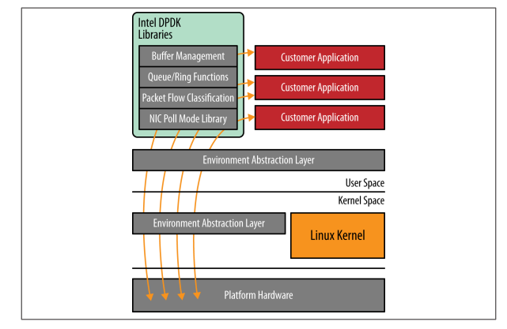
Intel Data Direct I/O Technology (Intel DDIO)—leverages integrated PCIe lanes on the CPU, reducing memory accesses and speeding up CPU data transfer, which is sometimes referred to as NIC core pinning.
Intel DPDK—Intel’s most recent innovation in I/O virtualization improvements, Dataplane Development Kit, provides data plane libraries and optimized (poll-mode) NIC drivers (for Intel NICs) in Linux user space that provide advanced queue and buffer management, and flow classification through a simple API interface.

Slide 15
Service Engineered Path
In 2010, a proposal to decouple the Service and Network infrastructure (plane) was proposed by Jim Guichard, then a principal architect in the CTO Office at Juniper Networks.
The Service Engineered Path (SEP) concept was introduced as a potentially new means of service delivery for the Service Provider community—a Juniper-specific solution, but one that solved the problem prior to any standardization of such a concept.
The problem statement addressed in SEP was that service providers were constrained in making new service offerings by the need to deploy the service appliances that would comprise the service offering.
Service offerings included firewalls, Intrusion Detection Systems (IDS), Intrusion Prevention Systems (IPS), load balancers, and SSL off-loaders that were run within the edge routers that would serve their projected markets.
These constraints made service introduction laborious and disruptive to network operation and put a premium on predicting the markets for a service where you could have too few subscribers and you have stranded resources, or too many subscribers and then need to install more appliances/blades.

Slide 16
Service Engineered Path - Motivation
Network devices that provide Service Enabling Technologies (SETs) would be transparent to the general network infrastructure.
Changes/additions/upgrades to one or more service instances wouldn’t affect routing in the network, providing a more stable service introduction environment.
Provide flexible service SET and instance placement, and streamlined capacity planning of services.
Faster time to market for services from a design, upgrade, testing, and deployment perspective.
Edge routers need not be upgraded every time a new service is added or upgraded with new functionality.
Providing the ability to link together services of differing types, thereby enabling new and innovative bundled services

Slide 17
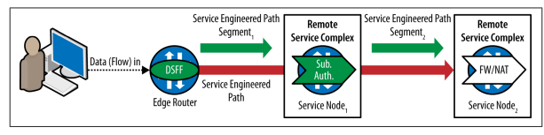
Basic SEP Concept
The construction of service was a hierarchy of the following components:
Service - A service function, application, or content used singularly or in collaboration with other SETs to enable a service.
SET Sequence Predetermined sequence of SETs that form the service.
Set Sequence Path As an instance of a SET may be available at multiple points in the network, there are potentially several combinations of Service Nodes that could form part of the SET sequence. The SET sequence path is a list of [Service Node, SET] combinations available that could be used to satisfy the service

